Slide 1
A Presentation on project
“IOT BASED MILITARY SURVEILLANCE ROBOT”

Slide 2
ABSTRACT
The main objective of this project is to develop a virtual
environment for detecting suspicious and targeted places
for user without any loss of human life. It is based on
development of a robot vehicle for observing/spying the
suspicious objects. It can continuously monitor the
objects. Robot can move in every direction (left, right,
forward and backward).It is used for video surveillance
and remotely control the particular place using Wi-Fi as
medium. The webcam which is placed on the robotic unit
will capture the video and it transmits lively to the
remote end. The major application of this paper can be
analysed using HTML web page which can be used to
control

Slide 3
INTRODUCTION
Earlier the robots were controlled through wired
networks but now to make robot more users
friendly, they are framed to make user commanded
work. There is no distance limitation issues in this
project. The robot is capable to work everywhere
where there is a wireless connection. This project
can be used for security purposes where we need to
get information about some suspicious area/people.
It acquires image from cameras through a web
Browser. it can also be very helpful in
explorers and animal psychologists need to observe
closely the life style of various dangerous animals

Slide 4
FLOW CHART
POWER
ARDUINO
GUN
Bomb detector
WIFI
POWER
CAMERA
MOTOR DRIVER
GPS

Slide 5
Scope and Possible Applications
Bomb sensing sensor
Camera enabled
Bomb location using GPS
Security purpose
Shoot unwanted

Slide 6
Hardware Components
GPS
Wi-fi module
Arduino
camera
Motor drivers
Motors
Bomb detector module
Power supply

Slide 7
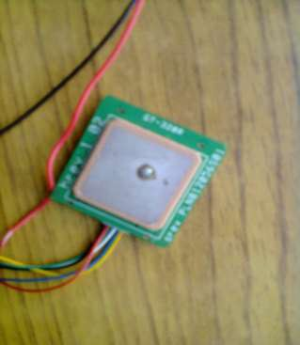
GPS (Global positioning system)
Serial Interface : RS-232 level
Supply voltage: 5 V
GPS receiver channel : 12 parallel
acquisition sensitivity : -140dBm
tracking sensitivity : -150dBm
hot start : < 10 secs
cold start : < 50 second
Protocol used :NMEA-0183 V3.01 GPRMC format

Slide 8
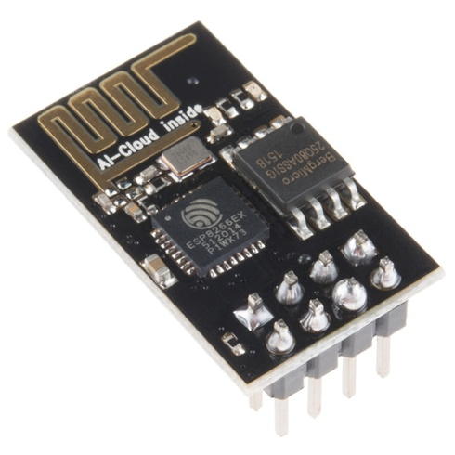
Wifi module
The chip first came to the attention of Western makers in August 2014 with the ESP-01 module, made by a third-party manufacturer Ai-Thinker. This small module allows microcontrollers to connect to a Wi-Fi network and make simple TCP/IP connections using Hayes-style commands.

Slide 9
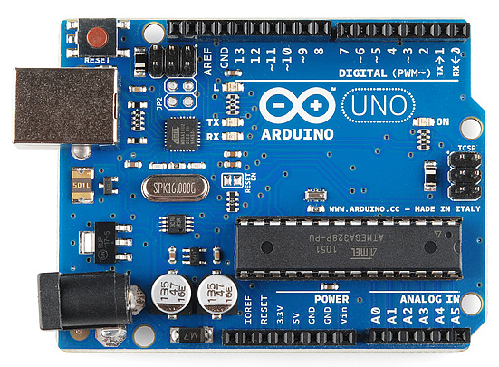
Arduino
The Arduino Uno is an open-source microcontroller board based on the Microchip ATmega328P microcontroller and developed by Arduino.cc. The board is equipped with sets of digital and analog input/output (I/O) pins that may be interfaced to various expansion boards (shields) and other circuits.

Slide 10
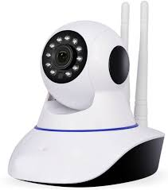
Camera
IP camera. ... An Internet Protocol camera, or IP camera, is a type of digital video camera that receives control data and sends image data via the Internet. They are commonly used for surveillance.

Slide 11
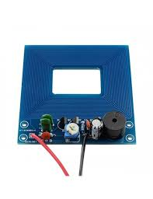
Bomb detector module
When electricity flows through the transmitter coil, it creates a magnetic field all around it. If you sweep the detector above a metal radiation , current flowing chemical composition object ,the magnetic field penetrates right through it. The magnetic field makes an electric current flow inside the object.

Slide 12
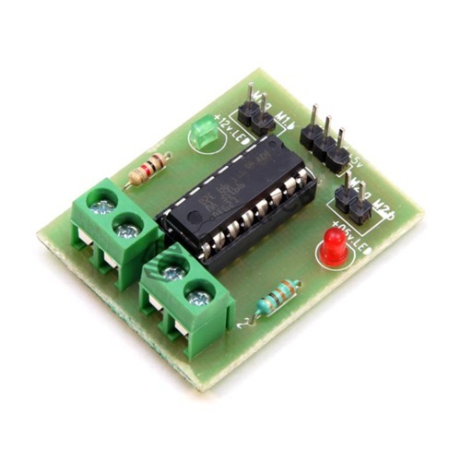
Motor driver –l293d
L293D is a typical Motor driver or Motor Driver IC which allows DC motor to drive on either direction. L293D is a 16-pin IC which can control a set of two DC motors simultaneously in any direction. It means that you can control two DC motor with a single L293D IC.

Slide 13
Software Requirements
Arduino compiler
Language: Embedded C
Proteus simulation

Slide 14
References
[1] B. C. B. S. Anil Gaire, "GPS GSM Integration for Enhancing Public Transportation System," Lalitpur, 2013.
[2] D. S. W. Andrew Sloss, ARM System Developer's Guide, San Francisco: Morgan Kaufmann, March 2004. pg. 103-155

[3] E. H. H. J. Xiaoya Guo, "Design a Smart Bus System," [Online]. Available: http://www.ece.uvic.ca/~bhung/399/minutes/Final_Report.pdf. [Accessed 20 february 2014].
[4] G. Developers, "Android Application Development.," [Online]. Available: http://developer.android.com/training/index.html. [Accessed 20 july 2014].
[5] "Manual of Board ET-BASE GSM SIM900," [Online]. Available:
http://www.etteam.com. [Accessed 6 june 2014].
[6] P. K. R. C. Bikash Poudel, "A Training M anual on FPGA and ARM," kathmandu.

Slide 15
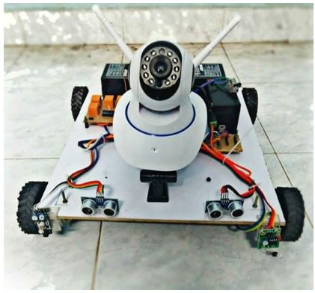
Final working model of robot

Slide 16
Thank you
?
31

